Slide 1
Module 3
B. Instruction Execution

Slide 2
Content
Instruction Execution Cycle (Fetch-Decode-Execute Cycle)
Types of instruction
  Register reference instructions
  Memory reference instructions
  Input-Output instructions

Slide 3
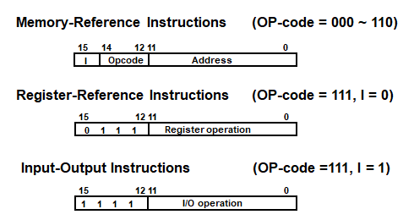
BASIC COMPUTER’S INSTRUCTIONS
Basic Computer Instruction Format
Figure 8. Basic computer instructions [1]

Slide 4
INSTRUCTION CYCLE
In Basic Computer, a machine instruction is executed in the following cycle:
  Fetch an instruction from memory
  Decode the instruction
  Read the effective address from memory if the instruction has an indirect address
  Execute the instruction
After an instruction is executed, the cycle starts again at step 1, for the next instruction
Note: Every different processor has its own (different) instruction cycle

Slide 5
Fetch-Decode-Execute Cycle
During the fetch part, the CPU fetches the next instruction from the address contained in the Program Counter and places the instruction in the Instruction Register.
  When a program starts, the program counter contains 0, so the instruction at address 0 is fetched.
As soon as an instruction is fetched, the CPU adds 1 word to the contents of the Program Counter, so that it will contain the address of the next sequential instruction.

Slide 6
Fetch-Decode-Execute Cycle
The decode unit within the CPU decrypts the instruction in the Instruction Register and determines:
  What operations need to be done, and
  What type of operands will be used
During the execution part, the specified operation is performed
  (add, compare, etc).
After execution of the instruction has been completed the cycle starts all over again (unless the instruction terminates the program).

Slide 7
Fetch-Decode-Execute Diagram
CPU
Main Memory
Fetch
Get instruction and increment PC
Program Counter (PC)
…
3020
3021
3022
3023
3024
3025
3026
3027
3028
…
3024
3023
Instruction Register
add r3, r1, r2
add r3, r1, r2
Decode
Determine what the instruction is (add)
General Purpose Registers
33
r1
r2
r3
45
Execute
In this case add r1 and r2 and put result in r3.
78
Fig. 1 [1] Fetch-Decode-Execute Diagram

Slide 8
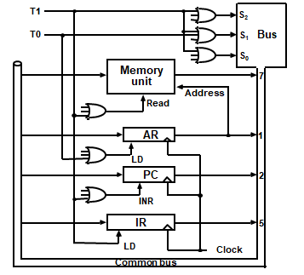
FETCH and DECODE
T0: AR ← PC (S₀S₁S₂=010, T0=1)
T1: IR ← M [AR], PC ← PC + 1 (S0S1S2=111, T1=1)
T2: D0, . . . , D7 ← Decode IR(12-14), AR ← IR(0-11), I ← IR(15)
To provide the data path for the transfer of PC to AR, we must apply timing signal T0 to achieve the following connection:
1. Place the content of PC onto the bus by making the bus selection inputs S2S1S0 equal to 010.
2. Transfer the content of the bus to AR by enabling the LD input of AR .
Fig. 2 [2] Register transfer for fetch phase

Slide 9
FETCH and DECODE
Timing signal T1 provide the following connections in the bus system:
Enable the read input of memory.
Place the content of memory onto the bus by making S2S1S0 = 111.
Transfer the content of the bus to IR by enabling the LD input of IR .
Increment PC by enabling the INR input of PC .

Slide 10
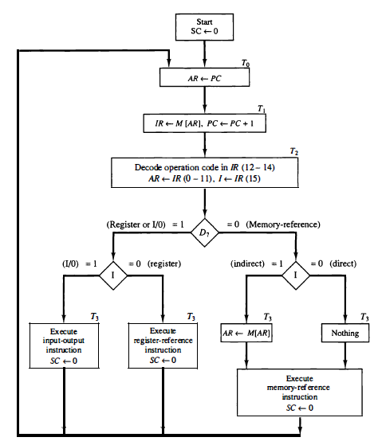

DETERMINING THE TYPE OF INSTRUCTION
Fig. 3 [2] Register transfer for fetch phase

Slide 11
DETERMINE THE TYPE OF INSTRUCTION
The three instruction types are subdivided into four separate paths.
The selected operation is activated with the clock transition associated with timing signal T3.
D7’ IT3: AR <-- M [AR]
D7’ I' T3: Nothing
D7 I' T3: Execute a register-reference instruction
D7IT3: Execute an input-output instruction

Slide 12
REGISTER REFERENCE INSTRUCTIONS
Register Reference Instructions are identified when
- D₇ = 1, I = 0
- Register Ref. Instr. is specified in b₀ ~ b₁₁ of IR
- Execution starts with timing signal T₃
r = D₇ I′T₃ => Register Reference Instruction
B_{i} = IR(i) , i=0,1,2,...,11
r: SC ← 0
CLA rB₁₁: AC ← 0
CLE rB₁₀: E ← 0
CMA rB₉: AC ← AC’
CME rB₈: E ← E’
CIR rB₇: AC ← shr AC, AC(15) ← E, E ← AC(0)
CIL rB₆: AC ← shl AC, AC(0) ← E, E ← AC(15)
INC rB₅: AC ← AC + 1
SPA rB₄: if (AC(15) = 0) then (PC ← PC+1)
SNA rB₃: if (AC(15) = 1) then (PC ← PC+1)
SZA rB₂: if (AC = 0) then (PC ← PC+1)
SZE rB₁: if (E = 0) then (PC ← PC+1)
HLT rB₀: S ← 0 (S is a start-stop flip-flop)

Slide 13
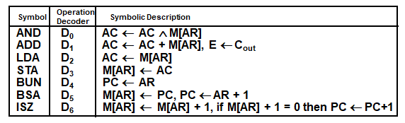
MEMORY REFERENCE INSTRUCTIONS
Fig. 4 [2] Register transfer for fetch phase
- The effective address of the instruction is in AR and was placed there during
timing signal T₂ when I = 0, or during timing signal T₃ when I = 1
- Memory cycle is assumed to be short enough to complete in a CPU cycle
- The execution of MR instruction starts with T₄
AND to AC
D₀T₄: DR ← M[AR] Read operand
D₀T₅: AC ← AC ∧ DR, SC ← 0 AND with AC
ADD to AC
D₁T₄: DR ← M[AR] Read operand
D₁T₅: AC ← AC + DR, E ← C_{out}, SC ← 0 Add to AC and store carry in E

Slide 14
MEMORY REFERENCE INSTRUCTIONS
LDA: Load to AC
D₂T₄: DR ← M[AR]
D₂T₅: AC ← DR, SC ← 0
STA: Store AC
D₃T₄: M[AR] ← AC, SC ← 0
BUN: Branch Unconditionally
D₄T₄: PC ← AR, SC ← 0
BSA: Branch and Save Return Address
M[AR] ← PC, PC ← AR + 1

Slide 15
MEMORY REFERENCE INSTRUCTIONS
BSA:
D₅T₄: M[AR] ← PC, AR ← AR + 1
D₅T₅: PC ← AR, SC ← 0
ISZ: Increment and Skip-if-Zero
D₆T₄: DR ← M[AR]
D₆T₅: DR ← DR + 1
D₆T₄: M[AR] ← DR, if (DR = 0) then (PC ← PC + 1), SC ← 0

Slide 16
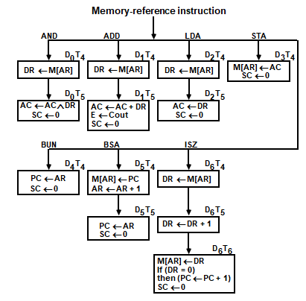
FLOWCHART FOR MEMORY REFERENCE INSTRUCTIONS
Fig. 5 [2] Flowchart for memory reference instructions

Slide 17
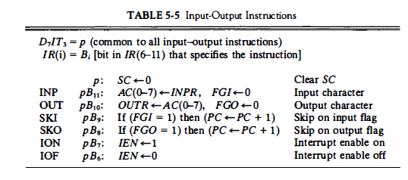
Input-Output Instructions
Fig. 6 [2] Input output instructions

Slide 18
References
[1]. Tanenbaum & Austin, Structured Computer Organization, 6th Edition, Pearson Education
[2]. M. Morris Mano, Computer System Architecture, Prentice Hall of India Pvt Ltd, 3rd Edition (upda ted) , 30 June 2017.
[3]. William Stallings, Computer Organization and Architecture–Designing for Performance, Ninth Edition, Pearson Education, 2013.

